Slide 1

SUPER JOB: THE NEW TRENDS
NAME-PRIYANSHU SINGH,MANIK
UID-18BET1057,18BET1098

Slide 2


A super job is the job with good salary, less working hour, smart team worker and freely Environment . A super Job are basically machine based.
A super job is a satisfaction which we get after doing it.

Slide 3
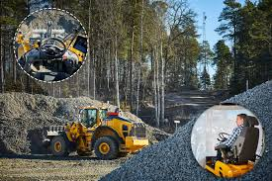
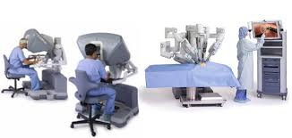
EXAMPLES
Super Job
(I) (II)

Slide 4

BENEFITS OF SUPER JOBS
HEALTH
HAVE ENOUGH TIME TO RELAX
MAXIMUM OUTPUT
Super-jobs are machine-powered

Slide 5

FUTURE OF SUPER JOB
A SURVEY CONDUCTED BY DELOITTE’S SHOWS FROM 10,000 COMPANIES 119 COUNTRIES SHOWS WITH THE GROWTH OF AI THE RATE OF SUPER JOB GROWTH RISES.

Slide 6


Advantage of super job
Time Efficient.
Work less get more.

Slide 7

Drawback of Super Job
If every think is done by machine than job will reduce.
Company only searching for smart worker.

Slide 8

THANK YOU

